Slide 1





Centre for Bhutan Studies
The 2010 Gross National Happiness Index : Part I
The Centre for Bhutan Studies
2011

Slide 2
Centre for Bhutan Studies
Part I:
GNH concept
GNH domains
GNH survey
33 indicators
Weighting
GNH thresholds-sufficiency & happiness
GNH Index methodology

Slide 3
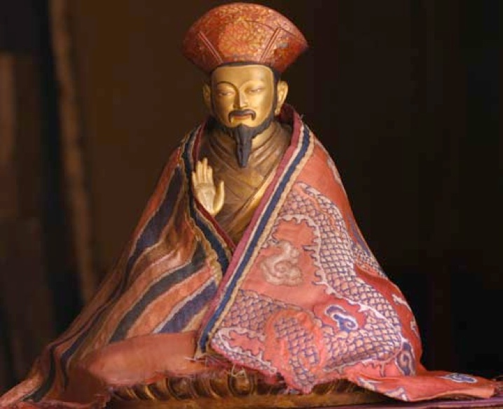
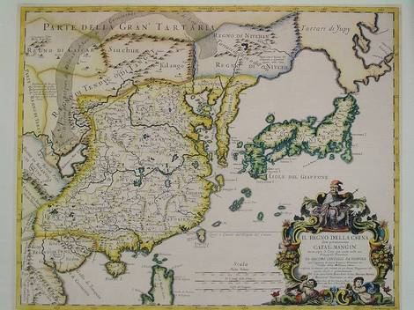
Background: Legal code of 1629 “if the government cannot create happiness for its people, then there is no purpose for government to exist.”

Slide 4
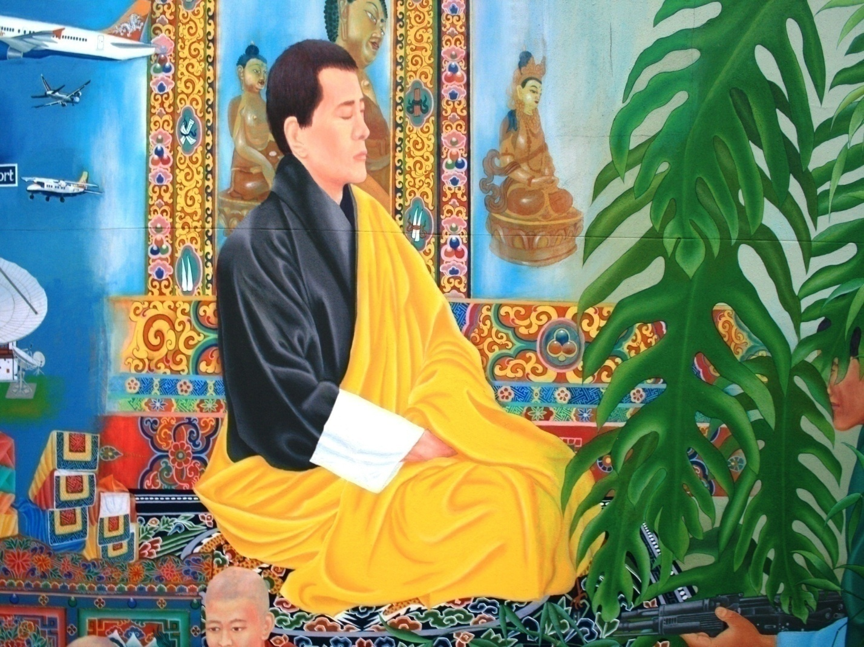
4th King of Bhutan, 1972 “Gross National Happiness is more important than Gross National Product.”

Slide 5
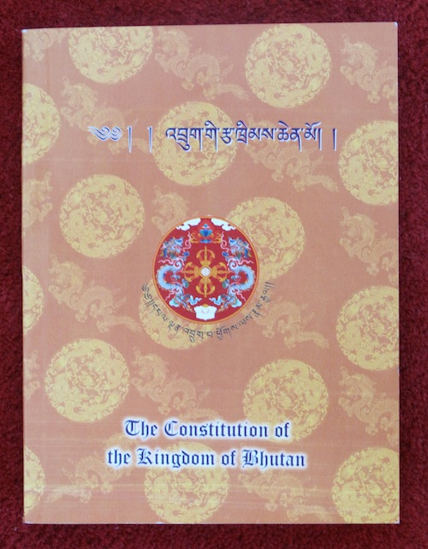
Constitution of Bhutan 2008 Article 9: “The State shall strive to promote those conditions that will enable the pursuit of Gross National Happiness.”

Slide 6
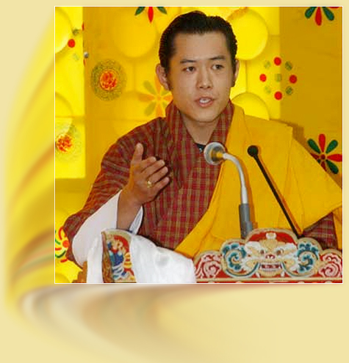
Gross National Happiness (GNH) measures the quality of a country in more holistic way and believes that the beneficial development of human society takes place when material and spiritual development occurs side by side to complement and reinforce each other.
HM Jigme Khesar Namgyel Wangchuck, the 5th King of Bhutan, is committed to GNH.

Slide 7
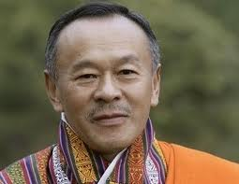
GNH in Bhutan: profound & rooted “We have now clearly distinguished the ‘happiness’ … in GNH from the fleeting, pleasurable ‘feel good’ moods so often associated with that term. We know that true abiding happiness cannot exist while others suffer, and comes only from serving others, living in harmony with nature, and realizing our innate wisdom and the true and brilliant nature of our own minds.” Prime Minister of Bhutan, 2009

Slide 8
Centre for Bhutan Studies
Part I:
GNH concept
GNH domains
GNH survey
33 indicators
Weighting
GNH thresholds-sufficiency & happiness
GNH Index methodology

Slide 9

GNH has Nine Domains:
These appear in the 10th plan
and are
Measured in the GNH Index.
Living
Standard
Education
Ecological Diversity and Resilience
Psychological
well-being
Health
Community Vitality
Time - Use
Good Governance
Cultural Diversity and Resilience

Slide 10
Nine Domains of GNH
Living Standard
Health
Education
Time Use
Good Governance
Ecological Diversity & Resilience
Psychological Well-being
Community Vitality
Culture Diversity & Resilience

Slide 11
Domains of GNH
Standard Domains
Living Standard
Health
Education
Time Use
Good Governance
Ecological Diversity & Resilience
Psychological Well-being
Community Vitality
Culture Diversity & Resilience

Slide 12
Domains of GNH
Living Standard
Health
Education
Newer Domains
Time Use
Good Governance
Ecological Diversity & Resilience
Psychological Well-being
Community Vitality
Culture Diversity & Resilience

Slide 13
Domains of GNH
Living Standard
Health
Education
Time Use
Good Governance
Ecological Diversity & Resilience
Innovative Domains
Psychological Well-being
Community Vitality
Culture Diversity & Resilience

Slide 14
Centre for Bhutan Studies
Part I:
GNH concept
GNH domains
GNH survey
33 indicators
GNH thresholds-sufficiency & happiness
Weighting
GNH Index methodology

Slide 15
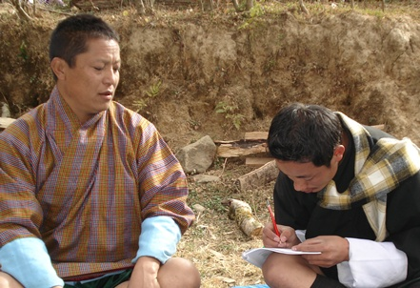
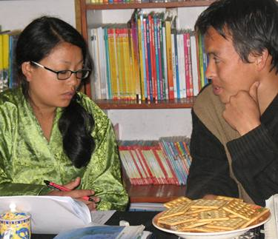
GNH Index Survey, 2010
CBS
Completed Interviews = 7142
Retained Sample size = 6476
Sample representative of 20 districts,
and by rural and urban areas
758 variables, covering all 9 domains of GNH
Unusual depth and quality of data
Draws on 2006 Pre-Pilot
and the 2008 Pilot GNH Survey
Centre for Bhutan Studies

Slide 16
Centre for Bhutan Studies
Part I:
GNH concept
GNH domains
GNH survey
33 indicators
Weighting
GNH thresholds-sufficiency & happiness
GNH Index methodology

Slide 17
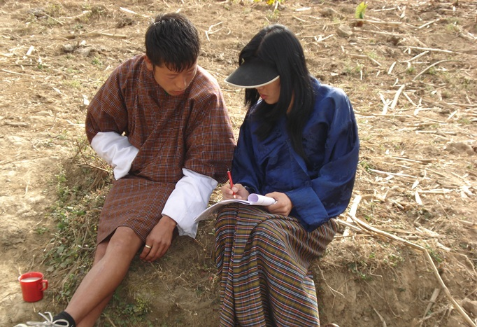
33 GNH Indicators were selected for the GNH Index according to: 1) Normative values, official documents 2) Statistical properties 3) Accuracy across time 4) Policy relevance 5) Clarity of interpretation The 33 indicators draw on over 120 questions from the survey.
Centre for Bhutan Studies

Slide 18
Centre for Bhutan Studies
 | Domain | Indicators
1 | Psychological wellbeing | 4
2 | Health | 4
3 | Time use | 2
4 | Education | 4
5 | Cultural diversity and resilience | 4
6 | Good Governance | 4
7 | Community vitality | 4
8 | Ecological diversity and resilience | 4
9 | Living standards | 3
 | Total | 33

Slide 19
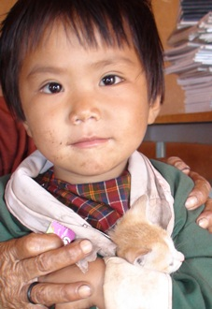
Centre for Bhutan Studies
Psychological Wellbeing
Life satisfaction
Positive emotions
Calmness
Empathy/ compassion
Generosity
Negative emotions
Anger
Spirituality level
Spirituality
Health
Living standard
Occupation
Relationships
Work-life balance
Forgiveness
Contentment
Fear
Worry
Selfishness
Jealousy
Prayer recitation
Meditation
Consideration of Karma
Notes:
Hypothetical classification of psychological wellbeing domain

Slide 20
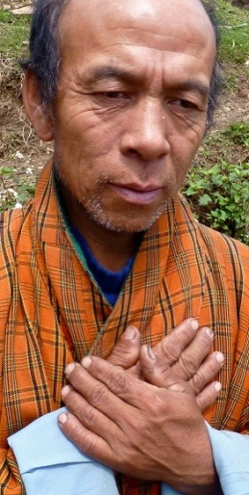
Health
Mental health:
Number of Healthy days
Self reported health status – 10% weight
Disability
Lost sleep over worry
Playing useful part
Long-term disability that restricts activities
Capable of making decisions
Constantly under strain
Difficult to cope with difficulties
Able to enjoy
Able to face problems
Feeling unhappy and depressed
Losing confidence
Thinking of self as a worthless person
Able to concentrate
Centre for Bhutan Studies
Notes:
Hypothetical classification of psychological wellbeing domain

Slide 21
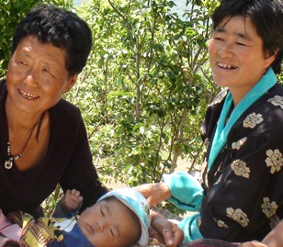
Time Use
WORK
SLEEP
Centre for Bhutan Studies
Notes:
Hypothetical classification of psychological wellbeing domain

Slide 22
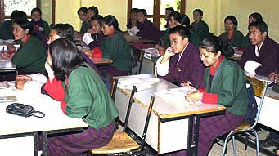
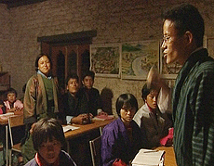
Education
Literacy
Knowledge of:
Local legends and folk stories
Schooling
Value : Little justification for
Local tshechus and festivals
Constitution
How HIV/AIDS is transmitted
Killing
Stealing
Lying
Creating disharmony among people
Sexual misconduct
Centre for Bhutan Studies
Notes:
Hypothetical classification of psychological wellbeing domain

Slide 23
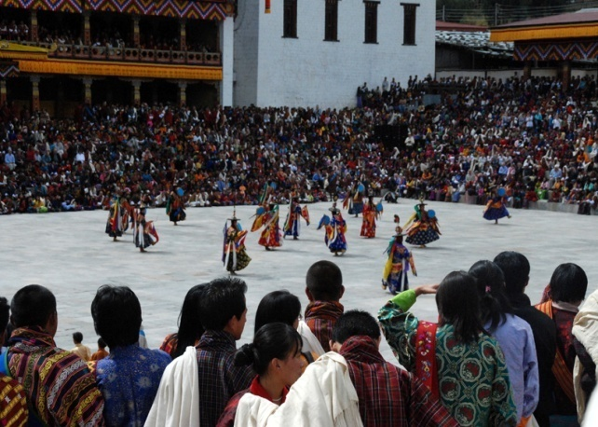
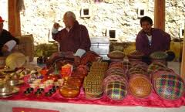
Cultural Diversity and Resilience
Cultural participation:
Speak native language
Driglam Namzha (code of etiquette and conduct)
Importance
Changes in practice
Number of days spent in socio-cultural events in a year
Weaving, Embroidery, Painting, Carpentry, Carving, Sculpture, Casting, Blacksmithing, Bamboo works, Gold/silversmith, Masonry, Leather works, Paper making
Artistic skills
Centre for Bhutan Studies
Notes:
Hypothetical classification of psychological wellbeing domain

Slide 24
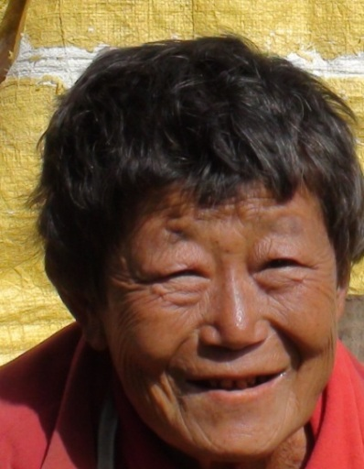
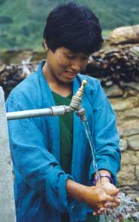
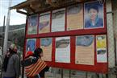
Centre for Bhutan Studies
Good Governance
Political participation
* Voting
* Attending Zomdue at:
Government performance
Creating jobs
Fundamental rights
Walking time to nearest health care centre
Services
Freedom of speech & opinion
Waste disposal
Quality of drinking water
Reducing gap between rich and poor
Fighting corruption
Protecting environment
Preserving cultural and traditions
Providing education
Improving health services
To vote
To join political party
To form/join tshogpa
To join public service
Equal value of work
Freedom from discrimination
Gewog level
Thromdue level
Chiwog level
Source of water
Access to electricity
Notes:
Hypothetical classification of psychological wellbeing domain

Slide 25
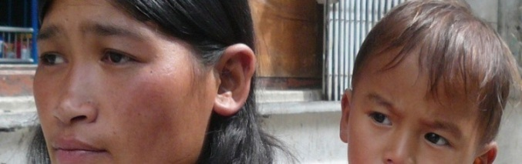
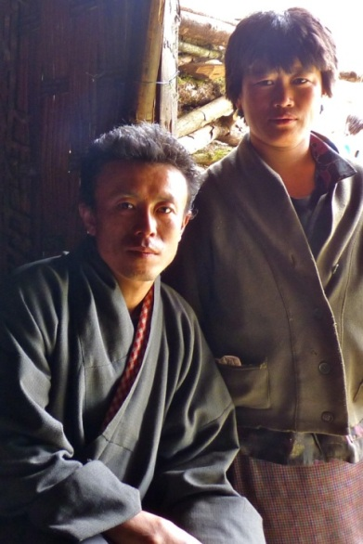
Community Vitality
Donations (time & money)
Family
Community relationship
Safety
Sense of belonging
Family care
Having been a recent victim of crime
Proportion of household income donated
Days of volunteering
Wish you were not part of your family
Argue too much
Feel like a stranger in family
Family are a real source of comfort
Trust neighbours
Family are understanding
Centre for Bhutan Studies
Notes:
Hypothetical classification of psychological wellbeing domain

Slide 26
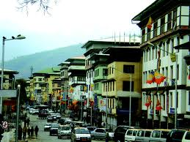
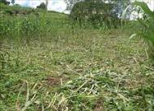
Ecological Diversity and Resilience
Responsibility towards Environment
Wildlife Damage (Rural)
Urbanization issues
Wild animals are a constraint to crops.
Crops have been damaged by wild animals
Noise pollution
Littering
Floods
Soil erosion
Landslides
Absence of waste disposal sites
Air pollution
Pollution of rivers and steams
Ecological Issues
Traffic congestion
Absence/inadequate green spaces
Lack of pedestrian friendly streets
Urban sprawl
Centre for Bhutan Studies
Notes:
Hypothetical classification of psychological wellbeing domain

Slide 27

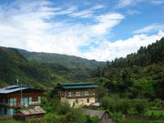
Living Standard
Assets
Household income per capita
Housing
Personal computer
Fixed phone
Refrigerator
Washing machine
Television
Livestock
Land size (5 acres threshold)
Mobile phone
Quality of roof
Electricity
Persons per room
Toilet
Centre for Bhutan Studies
Notes:
Hypothetical classification of psychological wellbeing domain

Slide 28
Centre for Bhutan Studies
GNH
Psychological Wellbeing
Health
Life satisfaction
Positive emotions
Negative emotions
Spirituality
Mental health
Self reported health status
Healthy days
Disability
Time Use
Work
Education
Literacy
Schooling
Knowledge
Value
Cultural Diversity and Resilience
Speak native Language
Cultural Participation
Artistic Skills
Driglam Namzha
Good Governance
Gov’t performance
Fundamental rights
Services
Political Participation
Community Vitality
Donations (time & money)
Community relationship
Family
Safety
Ecological Diversity and Resilience
Ecological Issues
Responsibility towards environment
Wildlife damage (Rural)
Urbanization issues
Living Standards
Assets
Housing
Household per capita income
Sleep
Notes:
Hypothetical classification of psychological wellbeing domain

Slide 29
Centre for Bhutan Studies
Part I:
GNH concept
GNH domains
GNH survey
33 indicators
Weighting
GNH thresholds-sufficiency & happiness
GNH Index methodology

Slide 30
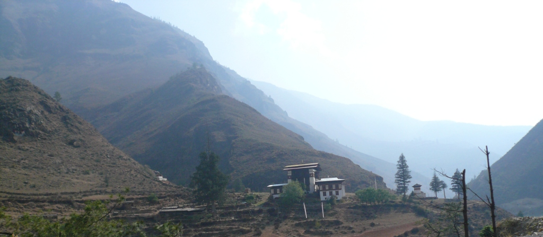
Centre for Bhutan Studies
Weighting:
9 domains are equally weighted
33 indicators, 2-4 per domain
Relatively equal weights among 33
Most reliable have larger weights

Slide 31
Centre for Bhutan Studies
Weights on the 33 Indicators

Slide 32
Centre for Bhutan Studies
Equal Weights within the indicators in 3 domains

Slide 33
Centre for Bhutan Studies
5 subjective indicators receive10% weights only (dark blue); others equal.

Slide 34
Centre for Bhutan Studies
In 3 domains, subjective indicators are weighted 20%; objective at 30%.

Slide 35
Centre for Bhutan Studies
Part I:
GNH concept
GNH domains
GNH survey
33 indicators
Weighting
GNH thresholds-sufficiency & happiness
GNH Index methodology

Slide 36
Centre for Bhutan Studies
How much is enough?
The GNH Index uses two kinds of thresholds:
1. Sufficiency thresholds
2. Happiness threshold
Sufficiency thresholds:
Shows how much a person needs in order to enjoy ‘sufficiency’ – how much is enough, normally, to create a happiness condition. Each of the 33 GNH indicators has a sufficiency threshold.

Slide 37
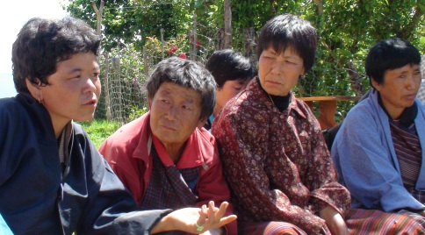
Centre for Bhutan Studies
Sufficiency thresholds were set by:
International standards: Eg. MDGs, ILO, Habitat
National standards: Eg.1.5 x income poverty line
Normative judgments: Eg. Positive emotions
Participatory meetings: Local advisors gave input - e.g. the threshold for land depends upon its quality. Here in Wangdiphodrang 5 acres is enough.

Slide 38
Centre for Bhutan Studies
Psychological wellbeing
Indicator | Sub-indicator | Question | Response range | Sufficiency
Life satisfaction | Health | How satisfied are you with your health? | 5 (Low-worst) To 25 (High satisfaction) | 20-25
 | Standard of living | …with your standard of living?
 | Occupation | …with your major occupation?
 | Family relationship | …with your family relationship?
 | Work life balance | …with your work life balance?
Spirituality | Spirituality | How spiritual do you consider yourself? | 1 (Not at all)- 4 (Very spiritual) | 4 (Very spiritual)
 | Karma | Do you consider Karma in the course of your daily life? | 1 (Not at all)-4 (Always) | 4 (Always)
 | Prayer recitation | How often do you recite prayers? | 1 (Not at all)- 4 (Regularly) | 4 (Regularly)
 | Meditation | How often do you meditate? | 1 (Not at all)- 4 (Regularly) | 3 (Occasionally) or 4 (Regularly)
Positive emotions | Calmness | During the past few weeks, how often do you experience __(Emotion)_? | 5 (Low )-20 (High positive emotion score) | 15-20 (Positive emotion score)
 | Compassion
 | Forgiveness
 | Contentment
 | Generosity
Negative emotions | Selfishness | During the past few weeks, how often do you experience __(Emotion)_? | 5 (Low)-20 (High negative emotion score) | 15-20 (Negative emotion score)
 | Jealousy
 | Fear
 | Worry
 | Anger

Slide 39
Centre for Bhutan Studies
Health
Indicator | Sub-indicator | Question | Response range (worst-best) | Sufficiency threshold
Self reported health status | Self reported health status | In general, would you say your health is… | 1 (Very poor)- 5 (Excellent) | 4 (Good) or 5 (Excellent)
Healthy days | Healthy days | Number of healthy days in the past 30 days | 0 (Worst)-30(Best) | Above 26 days
Disability | Long term disability | Do you have any long term disabilities, health/mental problems? | 1 (Yes)-2 (No) | 2 (No)
 | Activity limitations | Does the long-term disability restrict your activities? | 1 (All the time)- 5 (Never) | 3 (Rarely) or 4 (Never)
Mental health | 12 item General health questionnaire | 12 item General health questionnaire | 0-15 (Severe distress)-21-36 (Normal mental wellbeing) | 21-36 (Normal mental wellbeing)

Slide 40
Centre for Bhutan Studies
Education
Indicator | Sub-indicator | Question | Response range | Sufficiency
Literacy | Literacy level | Can you read and write in any of the languages? | 1 (No)-2 (Yes) | 2 (Yes)
Schooling | Schooling | What is your highest level of education? | 1 (No formal education)-8 (Postgraduate/PHD) | 2 (Class VI)
Know-ledge | Local legend and folk stories | How would you rate your knowledge and understanding on local legend and folk stories? | 5 (Low knowledge score)-25 (High knowledge score) | 19-25 (Knowledge score)
 | Local tshechus | How would you rate your knowledge and understanding on local tshechus?
 | Traditional songs | How would you rate your knowledge and understanding on traditional songs?
 | The Constitution | How would you rate your knowledge and understanding on constitution?
 | HIV/AIDS transmission | How would you rate your knowledge on how HIV/AIDS is transmitted?
 | Killing | Is killing justifiable? | 5 (Low value score)-15 (High value score) | 14-15 (Value score)
 | Stealing | Is stealing justifiable?
 | Lying | Is lying justifiable?
 | Disharmony | Is creating harmony in human relations justifiable?
Value | Sexual misconduct | Is sexual misconduct justifiable?

Slide 41
Centre for Bhutan Studies
Cultural diversity and resilience
Indicator | Sub-indicator | Question | Response range | Sufficiency
Language | Ability to speak mother tongue | How well can you speak your mother tongue now? | 1 (Not at all)-4 (Very well) | 4 (Quite well) or 5 (Very well)
Cultural participation | Number of days participated in socio-cultural activities | How many days do you spend in a year attending social and cultural acitivities (community festivals or choku of neighbours)? | 1 (None)-5 (More than 20 days) | 3 (6-12 days) or 4 (13-20 days) or 5 (More than 20 days)
Artisan skills | Artisan skills | Do you have any of the zorig chusum skills? | 0 skill (Worst)-13 skills (Best) | One skill or more
Driglam Namzha (code of etiquette and conduct) | Attitude | Is Driglam Namzha important? | 1 (Not Important)-3(Very Important) | 3 (Very Important-2 (Important)
 | Change over time | How do you percieve the change in practice and observance of Driglam Namzha during the last few years? | 1 (Getting weaker)-3 (Getting stronger) | 3 (Getting stronger)

Slide 42
Centre for Bhutan Studies
Good Governance
Indicator | Sub-indicator | Question | Range | Sufficiency
Government performance | Creating jobs | Rate the performance of government in creating jobs? | 7 (Low institutional performance score) - 35 (High institutional performance ) - | 28-25 (Institutional performance score
 | Reducing gap between rich and poor | in reducing gap between rich and poor?
 | Fighting corruption | in fighting corruption?
 | Preserving culture and traditions | in preserving culture and traditions?
 | Protecting environment | in protecting environment?
 | Providing educational needs | in providing educational needs?
 | Improving health services | n improving health services?
Fundamental Rights | Freedom of speech | Do you feel that you have right to the freedom of speech and opinion? | 1 (No)-2 (Yes) | 2 (Yes)
 | Vote | have right to vote? | 1 (No)-2 (Yes) | 2 (Yes)
 | Join political party | have right to join political party of your choice? | 1 (No)-2 (Yes) | 2 (Yes)
 | Form tshogpa | have right to form tshogpa? | 1 (No)-2 (Yes) | 2 (Yes)
 | Equal access to join public service | have right to equal access and opportunity to join public service? | 1 (No)-2 (Yes) | 2 (Yes)
 | To equal pay for equal work | have right to equal pay for work of equal value? | 1 (No)-2 (Yes) | 2 (Yes)
 | Free from discrimination | have right to the freedom from discrimination? | 1 (No)-2 (Yes) | 2 (Yes)
Services | Access to health care | How long does it usually take you to walk to the nearest health care centre? |  | <60 minutes
 | Electricity | Do you have electricity? | 1 (No)-2 (Yes) | 2 (Yes)
 | Waste disposal | How do you dispose your household waste? | 1 (Dump on open land)- 7 (Compost) | 5 (Municipal garbage pick up) or 6 (Burning) or 7 (Compositing)
 | Access to water | What is the main source of water for your household? | 1 (River, pond etc.)-8 (Piped in dwelling) | 5 (Protected well) or 6 (Public outdoor tap) or 7 (Piped water outside house) or 8 (Piped in dwelling)
 | Quality of water | How would you rate the quality of your drinking water | 1 (Very Poor)-5 (Very Good) | 5 (Very Good) or 4 (Good)
Political participation | Election | Will you vote in the next elections? | 1 (No)-2 (Yes) | 1 (No)
 | Zomdue participation | The frequency of zomdue attendance in the past 12 months |  | At least once

Slide 43
Centre for Bhutan Studies
Good Governance (cont’d)
Indicator | Sub-indicator | Question | Range | Sufficiency
Services | Access to health care | How long does it usually take you to walk to the nearest health care centre? |  | <60 minutes
 | Electricity | Do you have electricity? | 1 (No)-2 (Yes) | 2 (Yes)
 | Waste disposal | How do you dispose your household waste? | 1 (Dump on open land)- 7 (Compost) | 5 (Municipal garbage pick up) or 6 (Burning) or 7 (Compositing)
 | Access to water | What is the main source of water for your household? | 1 (River, pond etc.)-8 (Piped in dwelling) | 5 (Protected well) or 6 (Public outdoor tap) or 7 (Piped water outside house) or 8 (Piped in dwelling)
 | Quality of water | How would you rate the quality of your drinking water | 1 (Very Poor)-5 (Very Good) | 5 (Very Good) or 4 (Good)
Political participa-tion | Election | Will you vote in the next elections? | 1 (No)-2 (Yes) | 1 (No)
 | Zomdue participation | The frequency of zomdue attendance in the past 12 months |  | At least once

Slide 44
Centre for Bhutan Studies
Community vitality
Indicator | Sub-indicator | Question | Response range | Sufficiency threshold
Donation (time & money) | Donations | In the past 12 months, did you donate money? | Amount of donation made in a year | More than 10% of annual household income
 | Days volunteer | During the past 12 months, how many days did you volunteer? | Number of days volunteered | National average- More than 17 days
Community relationship | Sense of belonging | How would you describe your sense of belonging to your local community? | 1 (Weak)-3 (Very strong) | 3 (Very strong)
 | Trust in neighbours | How much do you trust your neighbours? | 1 (Trust none of them)-4 (Trust most of them) | 4 (Trust most of them)
Family | Family members care about each other | Do the members of your family care about each other? | 18 (High family index score)-6(Low family Index Score)
 | Wish you were not part of your family | Do you wish you were not part of your family?
 | Feel like a stranger in your family | Do you feel like a stranger in your family?
 | Enough time to spend with your family | Do you get enough time to spend with your family?
 | Lot of understanding in your family | Is there a lot of understanding in your family?
 | Family is a real source of comfort to you | Do you think family is a real source of comfort to you? |  | 15-18 (Family index score)
Safety | Victim of crime | Have you been a victim of crime in the last 12 months? | 1 (Yes)-2 (No) | 2 (No)

Slide 45
Centre for Bhutan Studies
Ecological diversity and resilience
Indicator | Sub-indicator | Question | Response range (worst-best) | Sufficiency threshold
Ecological issues | Pollution of rivers and streams | Is ___ISSUE________ an environmental issue of concern in your community? | 1 (Major concern)-4 (Not a concern) | 4 (Not a concern) or 3 (Minor concern) or 2 (Some concern) in at least 6 ecological issues
 | Air pollution
 | Noise pollution
 | Absence of waste disposal sites
 | Littering
 | Landslides
 | Soil erosion
 | Floods
Responsibility towards environment | Feelings of responsibility towards environment | Do you feel responsible for conserving the natural environment? | 1 (Not at all responsible)-4 (Highly responsible) | 4 (Highly responsible)
Wildlife damage (Rural) | Wildlife problems | Was wildlife a constraint to your crops during the last year? | 1 (Major constraint)-4 (Not a constraint) | 1 (Major constraint) & 1 (A lot) or 2 (Some)
 | Crop loss | In the past one year, has your crops been damaged by wild animals? | 1 (A lot)-4 (Not at all)
Urbanization issues | Traffic congestion | Is ___ISSUE________ an environmental issue of concern in your community? | 1 (Major concern)-4 (Not a concern) | 4 (Not a concern) or 3 (Minor concern) or 2 (Some concern) in at least 3 urbanization issues
 | Absence/inadequate green spaces
 | Lack of pedestrian friendly streets
 | Urban sprawl

Slide 46
Centre for Bhutan Studies
Living standards
Indicator | Sub-indicator | Question | Response range (worst-best) | Sufficiency threshold
Assets | Mobile telephone | Do you own a _______Equipment____ | 1 (No)-2 (Yes) | 3 electrical equipment or 5 livestock or 5 acres of land
 | Fixed line telephone
 | Personal computer
 | Refrigerator
 | Colour Television
 | Washing machine
 | Land | How many acres of land does your household own? | Number of acres
 | Livestock | How many livestock does your household own? | Number of livestock
Housing | Type of toilet used | What kind of toilet facility does your household use? | 1 (No toilet facility, open spaces)-5 (Flush toilet) | 5 (Flush toilets) or 4 (Pit latrine with septic tank)
 | Roof material | What type of roof material is mainly used for your dwelling? | 1 (Slate/Bamboo/ Straw/Wood/Mud)- 2 (Concrete/Brick/Stone/CGI/Metal) | 2 (Concrete/Brick/Stone or CGI/ Metal)
 | Room ratio | How many rooms are there in the dwelling (exclude bath/toilet)? | Number of persons per room | 2 persons per room or less
Household per capita income | Household income | What was the total cash income for your household during the past 12 months? | Household income in Ngultrums | 1.5* poverty line

Slide 47
Centre for Bhutan Studies
Time Use
Indicator | Sub-indicator | Question | Response range (worst-best) | Sufficiency threshold
Work | Hours of work |  |  | 480 mins
Sleep | Hours of sleep |  |  | 480 mins

Slide 48
Centre for Bhutan Studies
Most Bhutanese enjoy sufficiency in value, safety, native language, family, mental health, urbanization issues, responsibility towards environment, satisfaction in life, government performance, healthy days and assets

Slide 49
Centre for Bhutan Studies
50-60% of Bhutanese enjoy sufficiency in ecological issues, negative emotions, community relationship, Artisan skills, Driglam Namzha etc.

Slide 50
Centre for Bhutan Studies
Less than 50% of Bhutanese enjoy sufficiency in literacy, housing, donations, work, services, schooling, cultural participation and knowledge

Slide 51
Centre for Bhutan Studies
Who is considered Happy?
The GNH Index uses two kinds of thresholds:
1. Sufficiency thresholds
2. Happiness threshold
Happiness Threshold= 66% of domains
A person who enjoys sufficiency in more than six or more of the 9 domains is considered happy.

Slide 52
Centre for Bhutan Studies
Happiness threshold of 6 or more (66%) of the 9 domains were set based on:
Diversity: Some indicators do not have universal application. Eg. Political participation under Good Governance is not relevant to monks and nuns.
Measurement error: some responses might not be fully accurate, whether it be about household income or about their values
Freedom of choice: Many people seem fully happy without sufficiency in all indicators. They might not value other indicators. Their happiness might not be increased by requiring sufficiency in all. They have enough.

Slide 53
Centre for Bhutan Studies
39% of Bhutanese are happy in this indicator means 39% fulfill the conditions of both thresholds ; 1) sufficiency threshold of value indicator and 2) the overall happiness threshold of 6 of the 9 domains

Slide 54

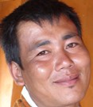
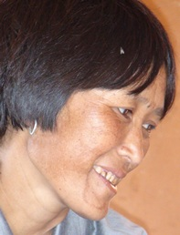
A person is ‘happy’ if he/she achieves sufficiency in 6 or more of the 9 domains
Centre for Bhutan Studies
Tashi
Sufficiency in 4 domains so she is considered unhappy
Dorji
Sufficiency in 7 domains, so he is considered happy

Slide 55
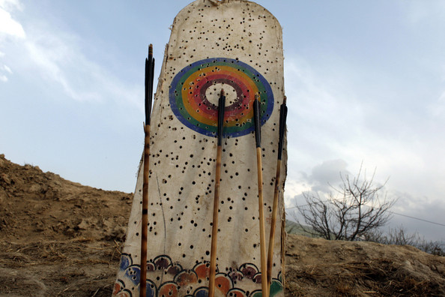
A person is ‘happy’ if he/she achieves sufficiency in 6 or more of the 9 domains
Centre for Bhutan Studies
How many hit the target?

Slide 56
Centre for Bhutan Studies
How can another know?
Happiness is deeply personal.
Any measure is imperfect.
It can only suggest.
Yet…

Slide 57
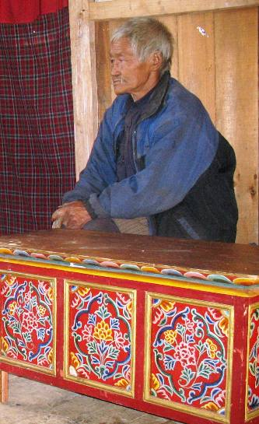

Centre for Bhutan Studies
40.8% of Bhutanese
enjoy sufficiency in
six or more domains
at the same time.
According to the GNH Index, they are ‘happy’.

Slide 58
Centre for Bhutan Studies
Part I:
GNH concept
GNH domains
GNH survey
33 indicators
GNH thresholds-sufficiency & happiness
Weighting
GNH Index methodology

Slide 59
Centre for Bhutan Studies
GNH Index Methodology
The GNH Index is related to:
1. Headcount ratio:
Percent of people who are happy
2. Breadth:
The percentage of domains in which people who are not-yet-happy enjoy sufficiency

Slide 60
Centre for Bhutan Studies
The 2010 GNH Index, like the 2008 Index, is based on the Alkire & Foster (2007, 2011) methodology. In this methodology we:
Choose indicators
Apply sufficiency thresholds (who has enough)?
Apply weights for each indicator
Apply the happiness threshold
Identify two groups:
Happy people
Not-yet happy people (policy priority)

Slide 61
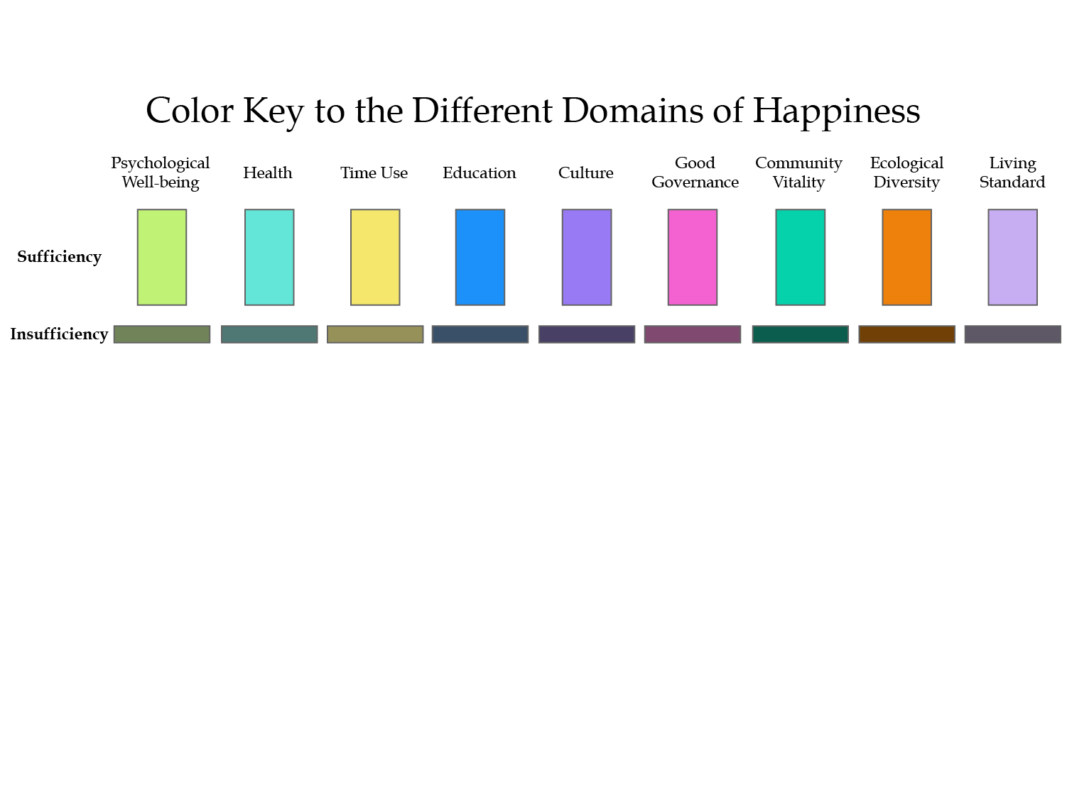
The first thing we do is apply sufficiency thresholds to each of the 33 indicators.
For simplicity, here we present as if we had nine indicators, one per domain, equally weighted.
We start with each person, one by one, and create their GNH profile.
The tall coloured bar indicates that a person has achieved sufficiency in that domain
The flat dark bar means that they lack sufficiency.

Slide 62
The first thing we do is apply sufficiency thresholds to each of the 33 indicators.
For simplicity, here we present as if we had nine indicators, one per domain, equally weighted.
We start with each person, one by one, and create their GNH profile.
The tall coloured bar indicates that a person has achieved sufficiency in that domain
The flat dark bar means that they lack sufficiency.

Slide 63
The first thing we do is apply sufficiency thresholds to each of the 33 indicators.
For simplicity, here we present as if we had nine indicators, one per domain, equally weighted.
We start with each person, one by one, and create their GNH profile.
The tall coloured bar indicates that a person has achieved sufficiency in that domain
The flat dark bar means that they lack sufficiency.

Slide 64
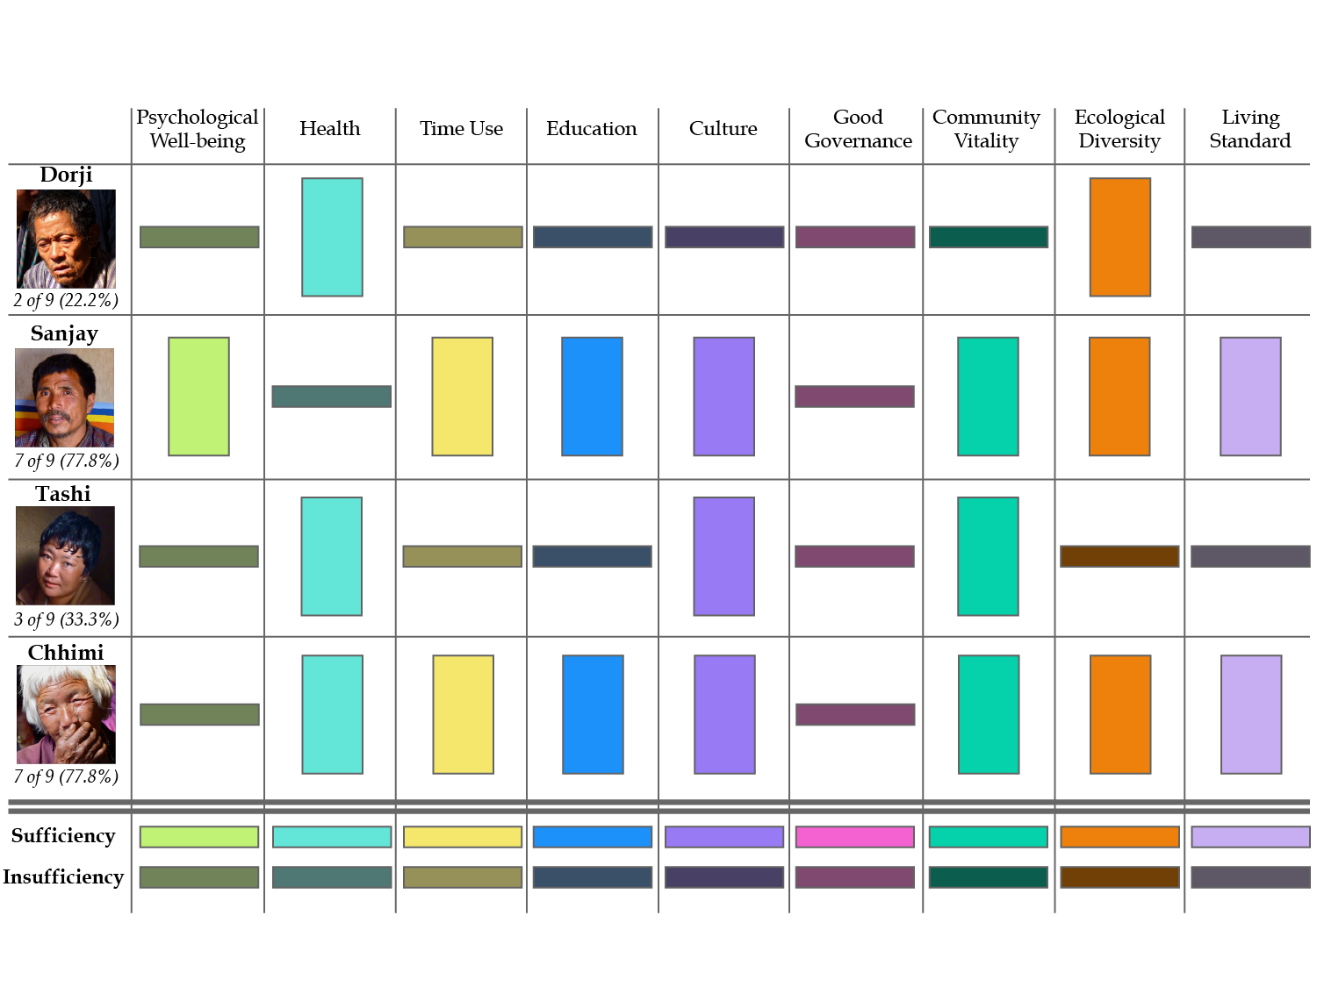
Sample GNH profiles

Slide 65
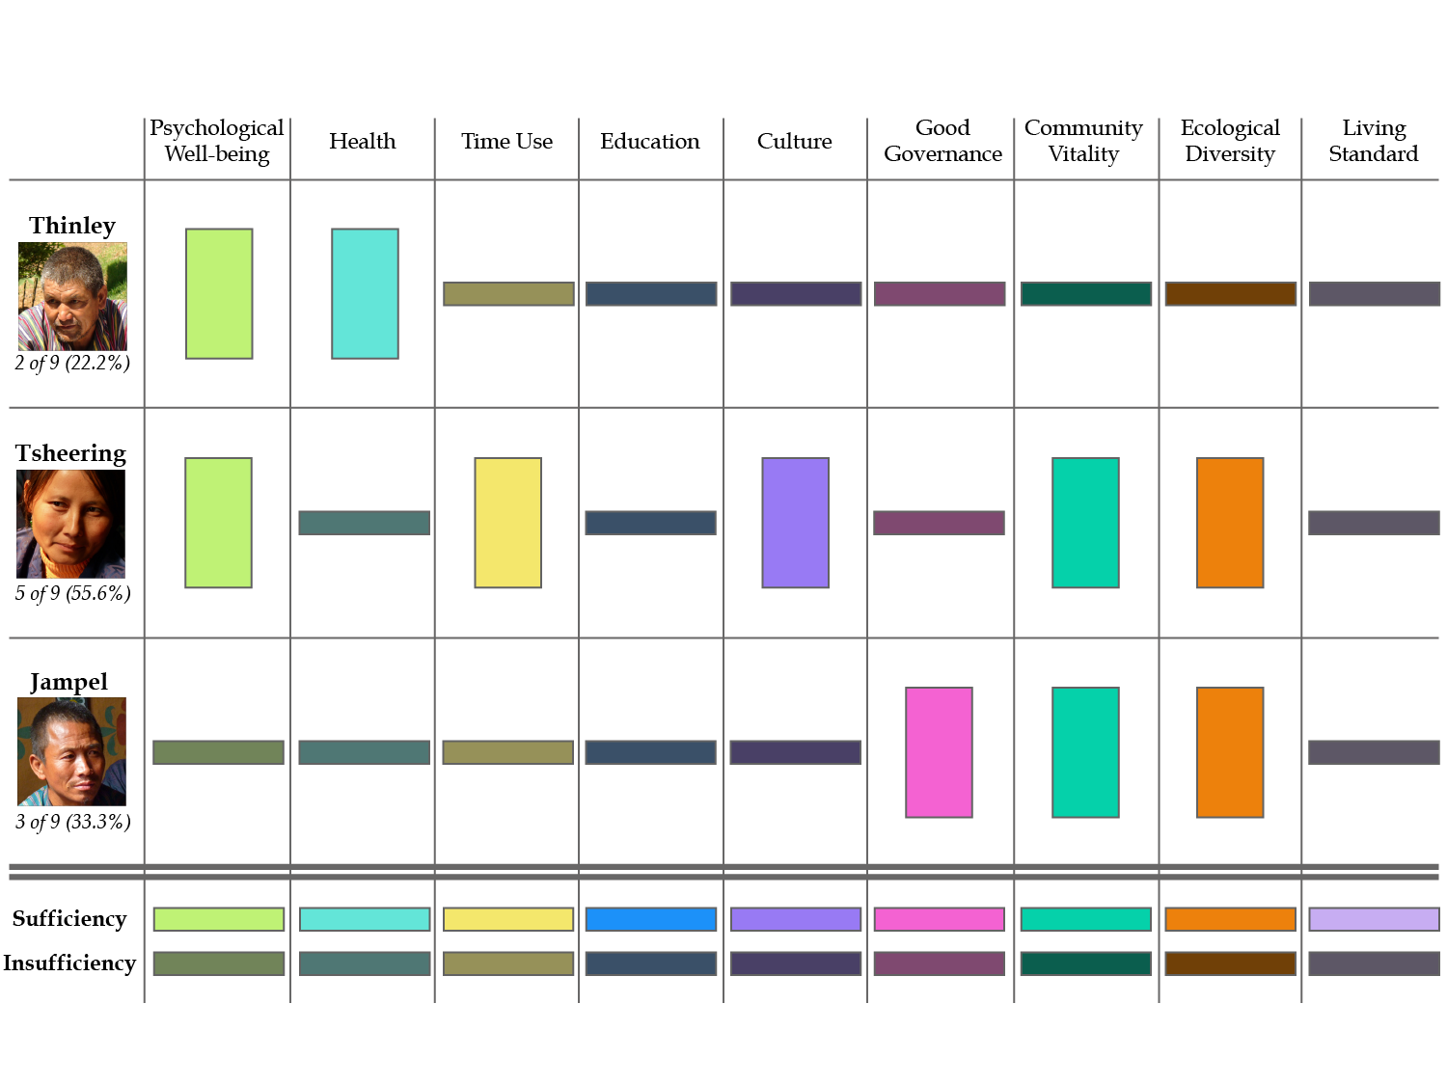
Sample GNH profiles

Slide 66
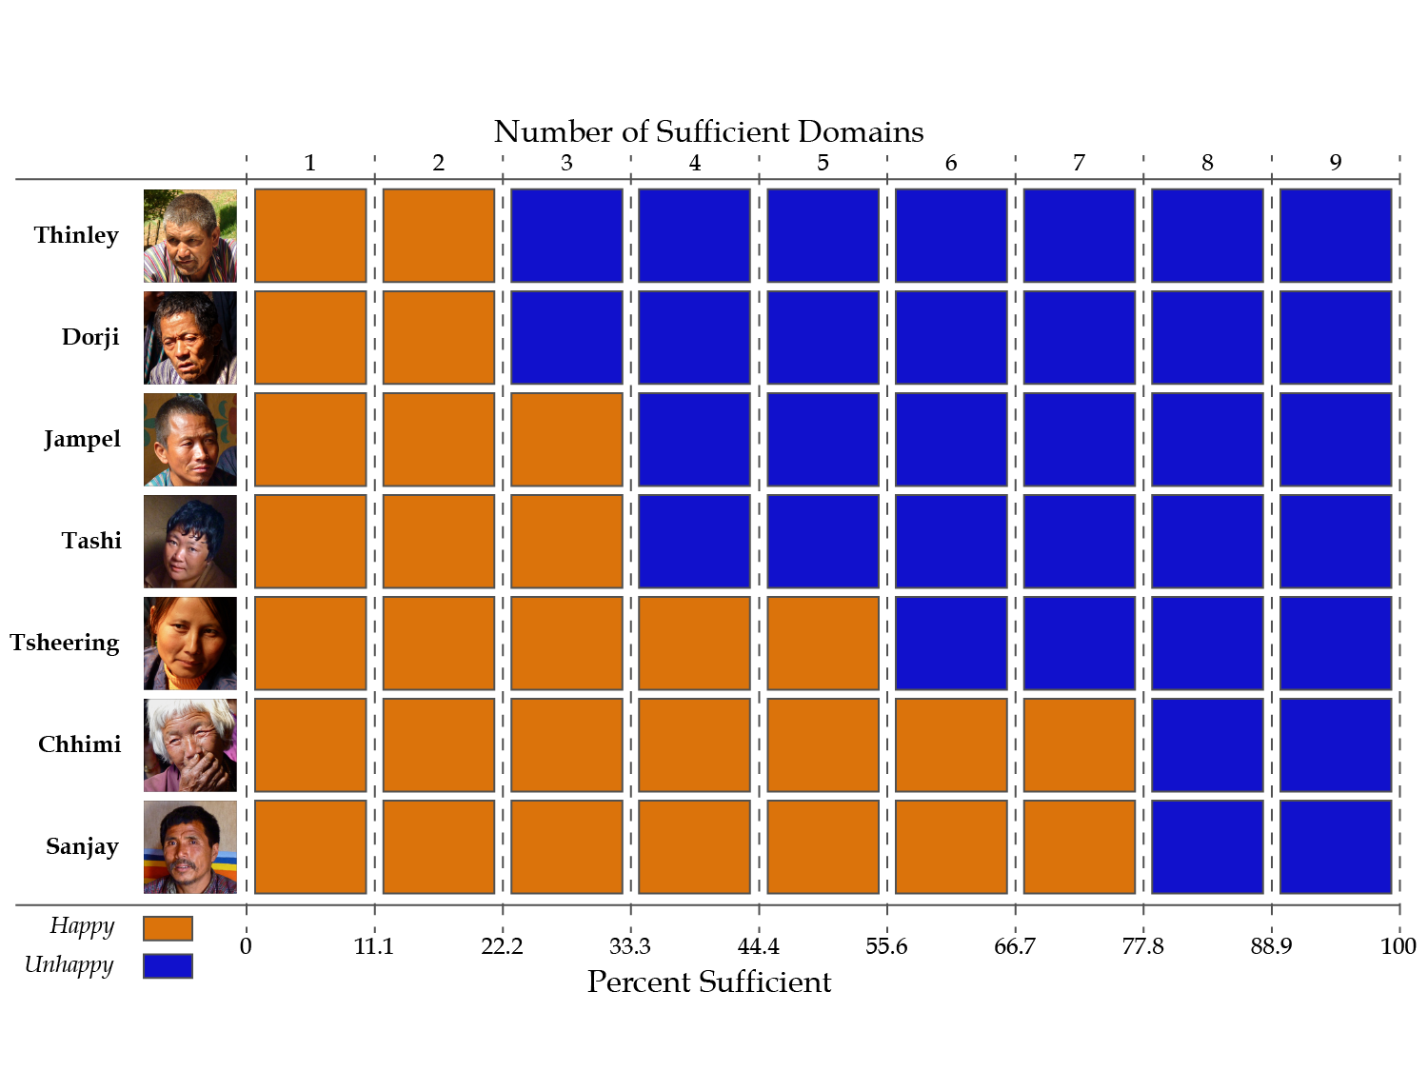
Next: Count domains (%)
Jampel has sufficiency in 3 of 9 domains (orange). That is, 33%.

Slide 67
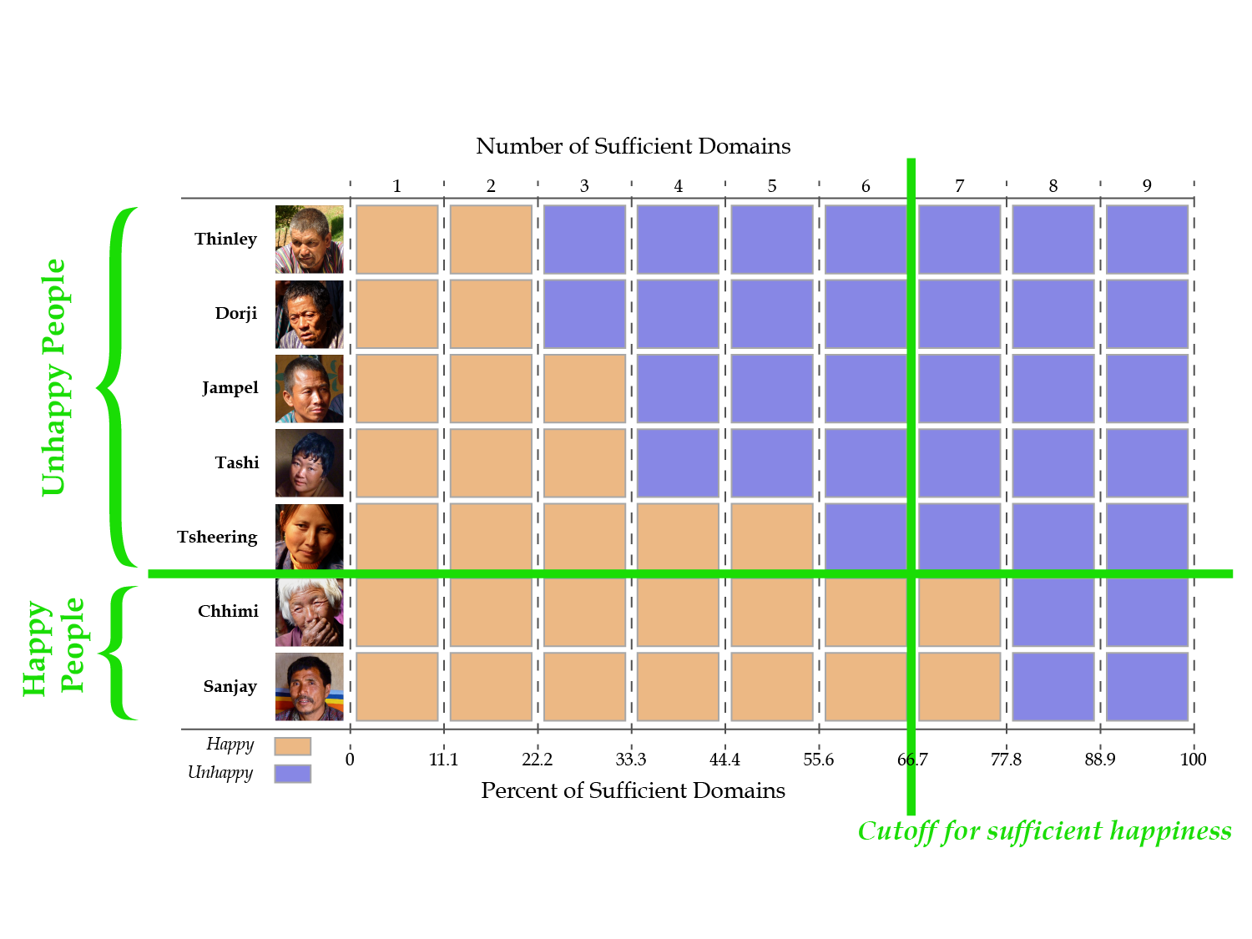
Next: who is happy?
A person who has 6 or more domains is happy

Slide 68
What % of people are happy
And what % are not-yet-happy?
Here 5 out of 7 people are not yet happy – 5/7 = 71%.
2 out of 7 people are happy – 2/7 = 29%
Happy people

Slide 69
Centre for Bhutan Studies
GNH Index Methodology
Almost there.
Now, to compute the GNH Index, we only need to know one more thing:
6. Among the Not-yet-Happy people, what percentage of domains do they lack sufficiency?

Slide 70
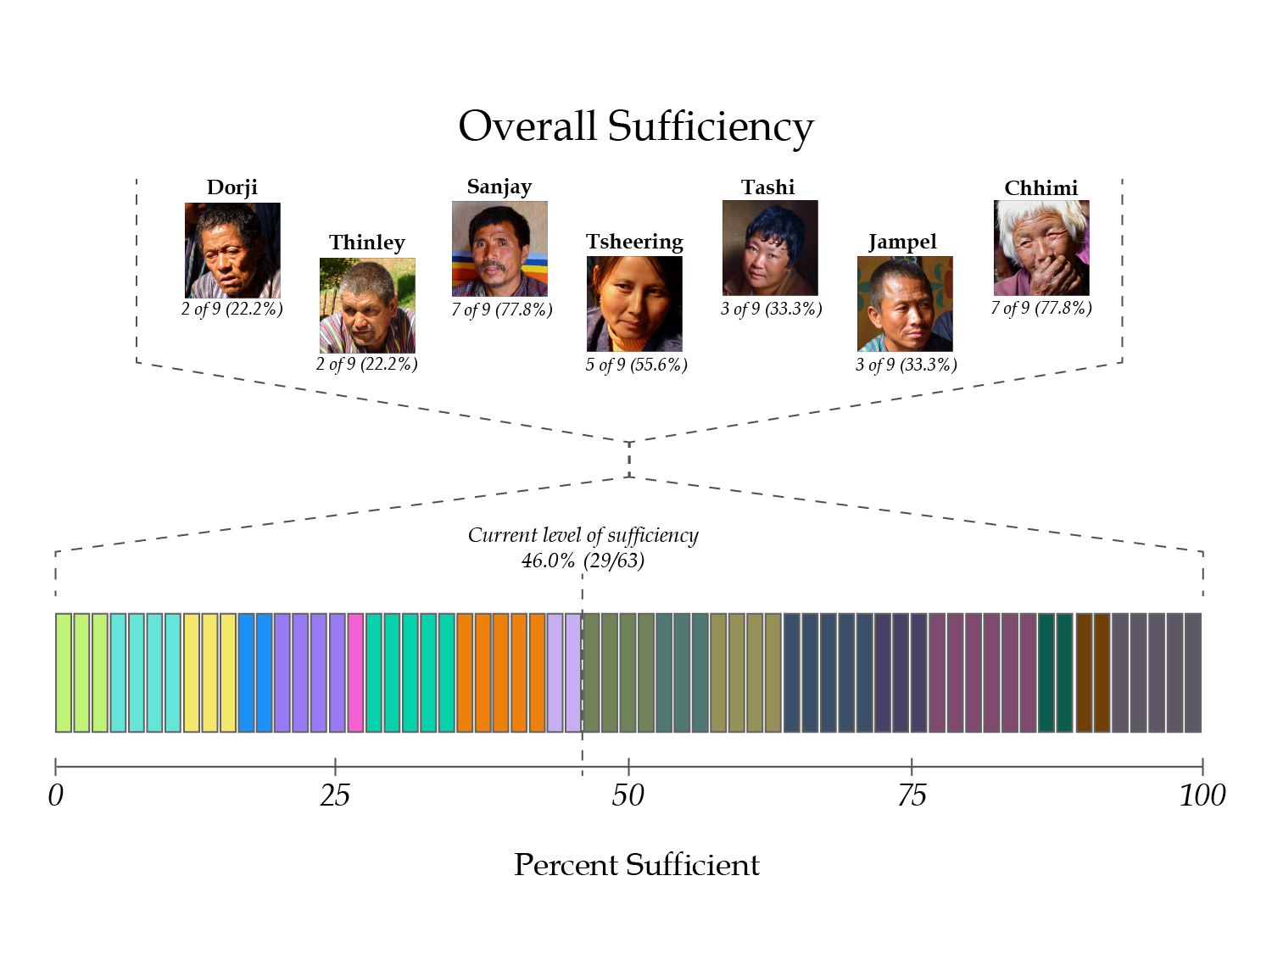
Last step: among the not yet happy…
In what percent of dimensions do they lack sufficiency?

Slide 71
Last step: among the not yet happy…
In what percent of dimensions do they lack sufficiency?
Have sufficiency in 46% Lack sufficiency in 54%

Slide 72
Centre for Bhutan Studies
The percentage of Happy people we call H_{h}
This is 29% in the example
The percentage of not-yet-happy people H_{n}
This is 71% in the example
The percentage of domains in which not-yet-happy people lack sufficiency we call A_{n}
This is 54% in the example

Slide 73
Centre for Bhutan Studies
Why does the GNH Index use shortfalls?
So the GNH Index changes when the percent of happy people increases or when not-yet-happy people have sufficiency in more domains.
(This makes it useful for policy)

Slide 74
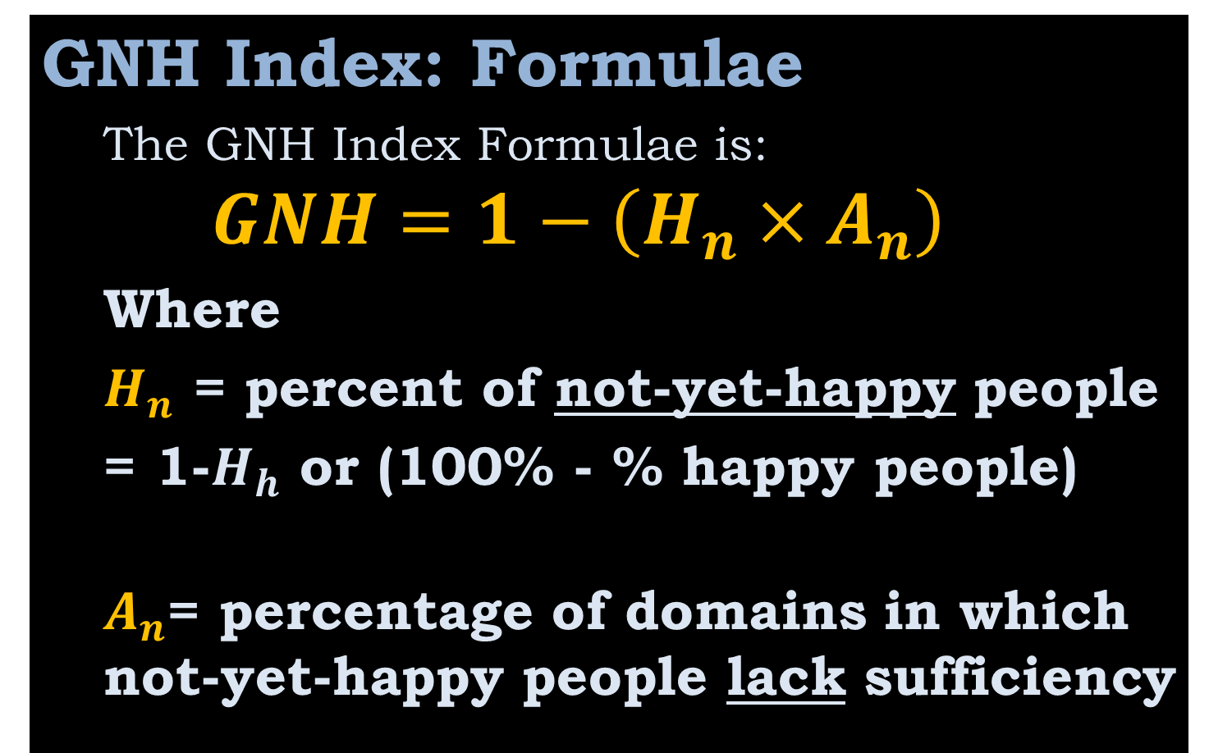
Centre for Bhutan Studies
GNH Index: Formulae
The GNH Index Formulae is:
$$GNH=1−\left(H_{n}×A_{n}\right)$$
Where
$H_{n}$ = percent of not-yet-happypeople
= 1-$H_{h}$ or (100% - % happy people)
$A_{n}$= percentage of domains in which not-yet-happy people lack sufficiency

Slide 75
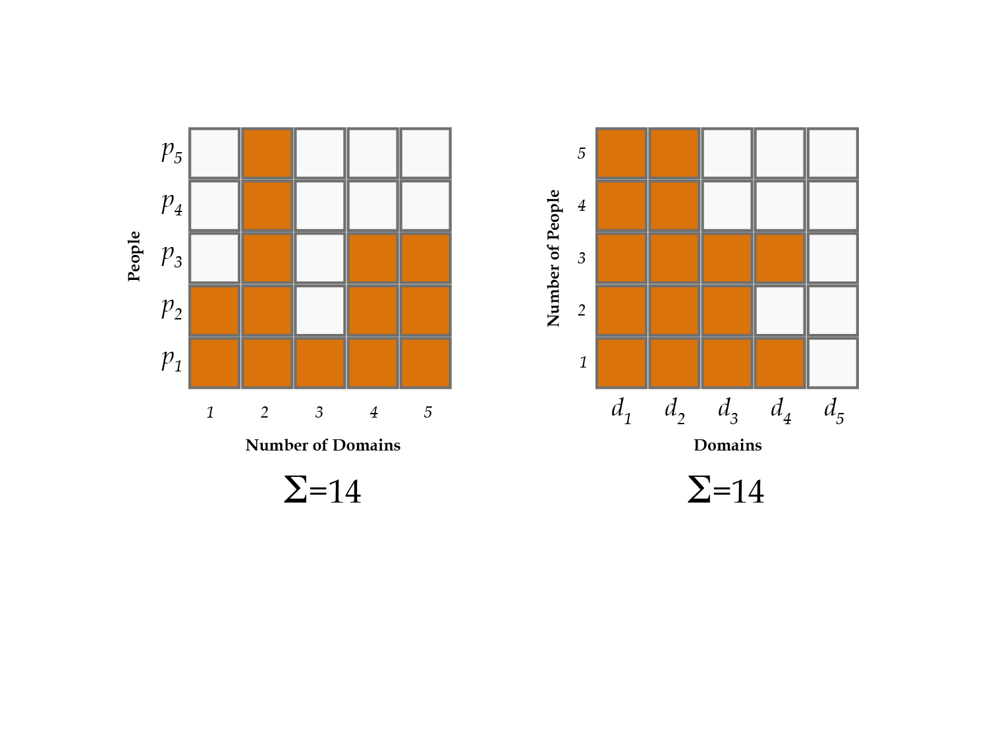
Now that we’ve computed it, the GNH can be unpacked in different ways, to tell different stories.
The GNH Index can be decomposed by subgroups like Dzonkhags, age groups, gender, or some occupations.
It can also be analysed by each dimension & indicator.

Slide 76
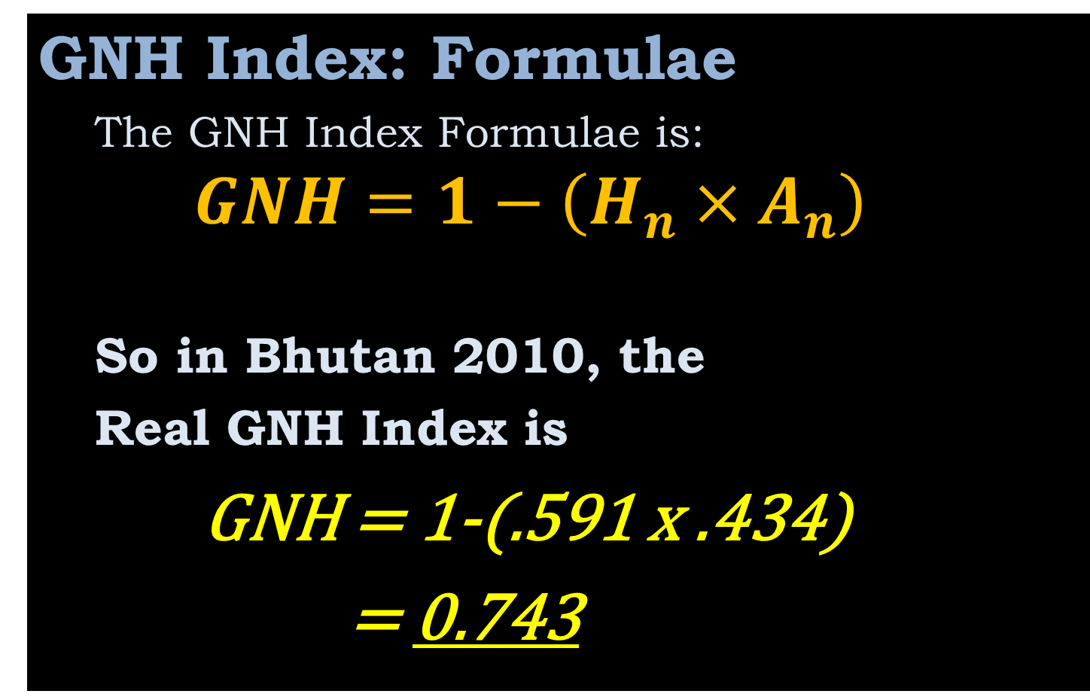
Centre for Bhutan Studies
GNH Index: Formulae
The GNH Index Formulae is:
$$GNH=1−\left(H_{n}×A_{n}\right)$$
So in Bhutan 2010, the
Real GNH Index is
GNH = 1-(.591 x .434)
= 0.743

Slide 77
Centre for Bhutan Studies
Hence, GNH Index is used:
To Understand Happiness:
How many people are happy?
How are they happy?
To Increase Happiness
Who is not yet happy?
What do they lack?

Slide 78
Centre for Bhutan Studies
How do we increase GNH?
Increase the % of happy people (Reduce the % of unhappy)
OR
Increase the % of domains in which not-yet-happy people enjoy sufficiency. (Reduce the insufficiencies of the unhappy).

Slide 79
Centre for Bhutan Studies
GNH Index: Incentives
The 2010 GNH Index, like the 2008 Index, is based on the Alkire & Foster methodology.
It provides an incentive
~to sustain GNH among the happy and
~to care for those who are not-yet-happy
… so they enjoy sufficiency in more domains
… and so they become happy.

Slide 80
Centre for Bhutan Studies
The 2010 Gross National Happiness Index : Part I
The Centre for Bhutan Studies
2011

